Slide 1

DATA SCIENCE AND MACHINE LEARNING

Slide 2
BOOTCAMP STRUCTURE
DAY 1 - PANDAS AND NUMPY
DAY 6-POLYNOMIAL REGRESSION
DAY 11 - NAIVE BAYES
DAY 2 - MATPLOTLIB AND SEABORN
DAY 7 - LOGISTIC REGRESSION
DAY 12 - KNN
DAY 3 - DATA ANALYSIS / EDA
DAY 8 - DECISION TREE
DAY 13 - SVM
DAY 4 - MACHINE LEARNING
DAY 9 - RANDOM FOREST
DAY 14- CLUSTERING ALGORITHMS
DAY 5 - LINEAR REGRESSION
DAY 10 - XG BOOST
DAY 15 - DEPLOYING MODELS

Slide 3
WHY VISUALIZE THE DATA ?
We understand and process information more easily when presented visually or through graphs.
A visual summary of information makes it easier to identify patterns and trends.
We can communicate our findings more easily through our graphs.

Slide 4
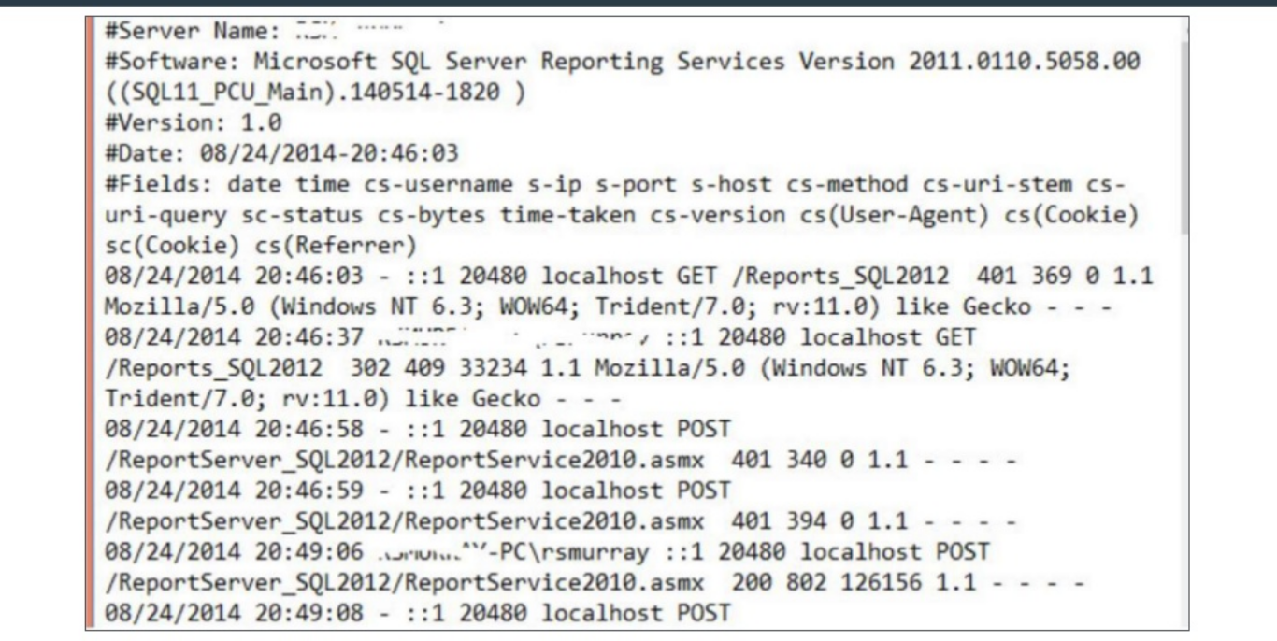
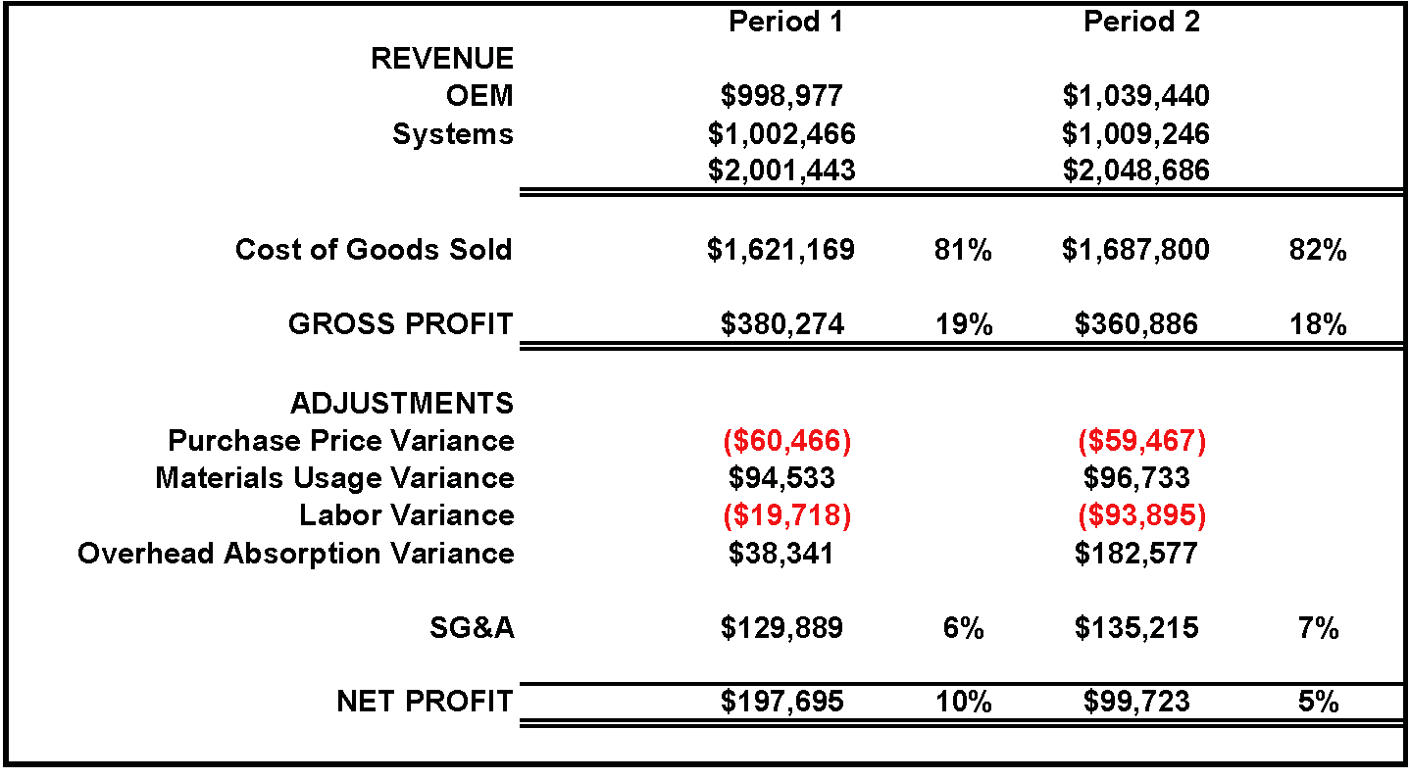

Slide 5
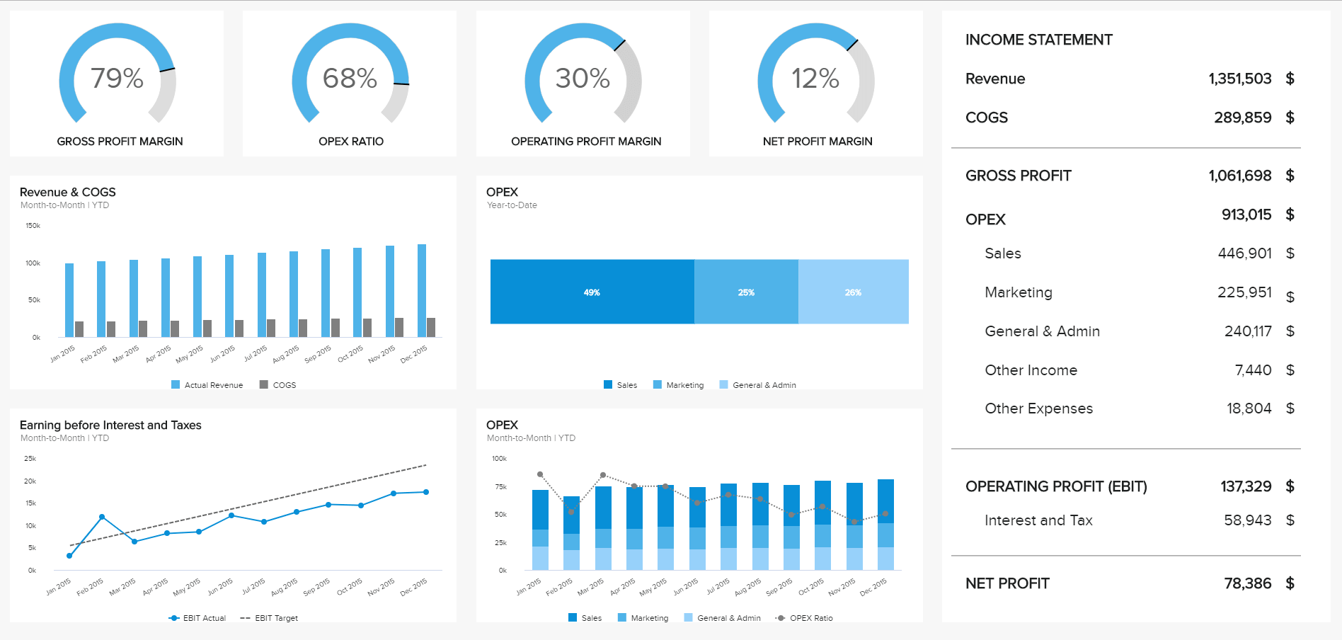
REPRESENTING INFORMATION THROUGH GRAPH

Slide 6
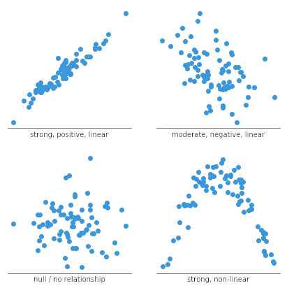

Slide 7
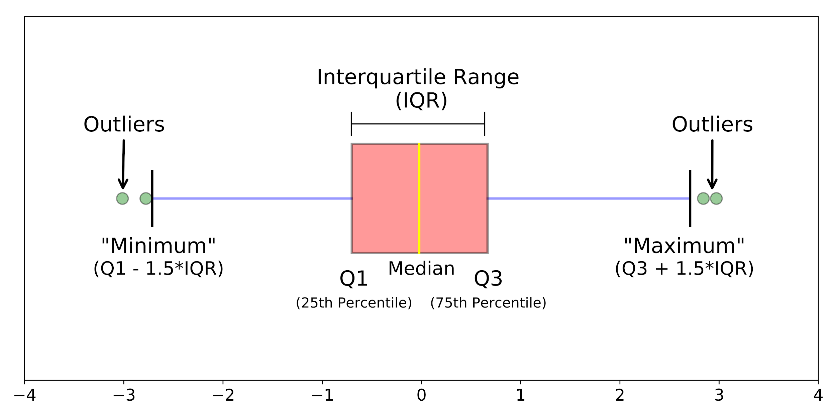

Slide 8
HOW CAN WE VISUALIZE OUR DATA USING PYTHON ?
There are many packages in python to visualize data.
Mostly commonly used packages are matplotlib and seaborn
Mainly used for basic plotting.
We can make line plot,bar graphs, pie graphs, histograms etc.
It is well integrated with numpy and pandas.
Base on matplotlib with fewer syntax.
We get default styles and themes for plotting.
Provides variety of plotting options.
Specializes in statistics visualizations.
MATPLOTLIB
SEABORN

Slide 9
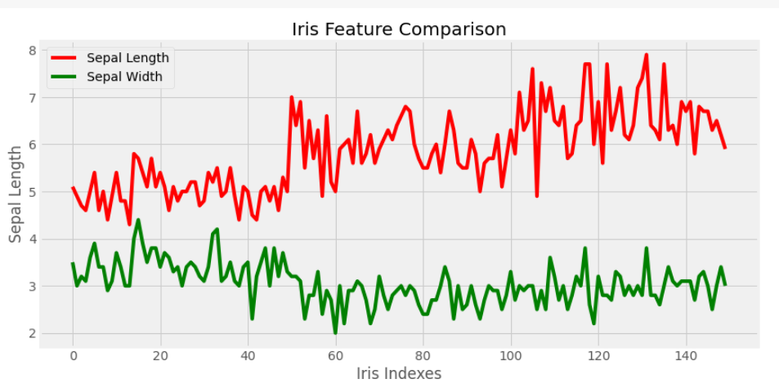
COMPONENTS OF A GOOD GRAPH ?
TITLE
COLOR LABELS(LEGEND)
AXES
LABELS
PROPER TICKS

Slide 10
TYPES OF DATA VISUALIZATION CHARTS
LINE CHARTS
PIE CHARTS
BAR CHARTS
HEAT MAPS
HISTOGRAMS
DENSITY PLOTS
SCATTER PLOTS
BOX PLOTS

Slide 11
WE CAN NEVER GET AWAY FROM CODING!
TIME TO CODE!

